Slide 1
MOEA-FIND proposal

Slide 2
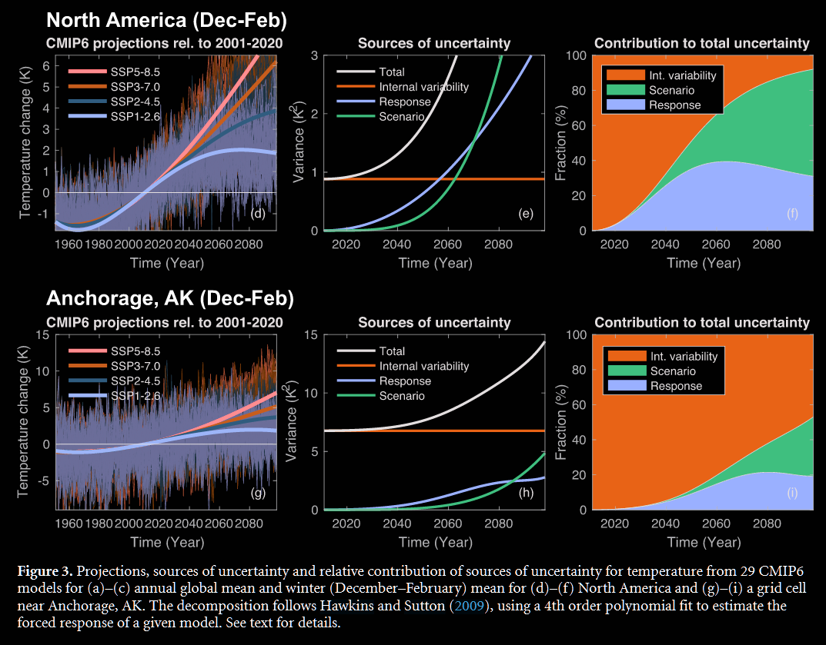

Synthetic generation literature reviews
“At regional or local scales… internal variability remains important or even dominant for a longer time, as climate tends to be more variable at smaller spatial scales”

Slide 3

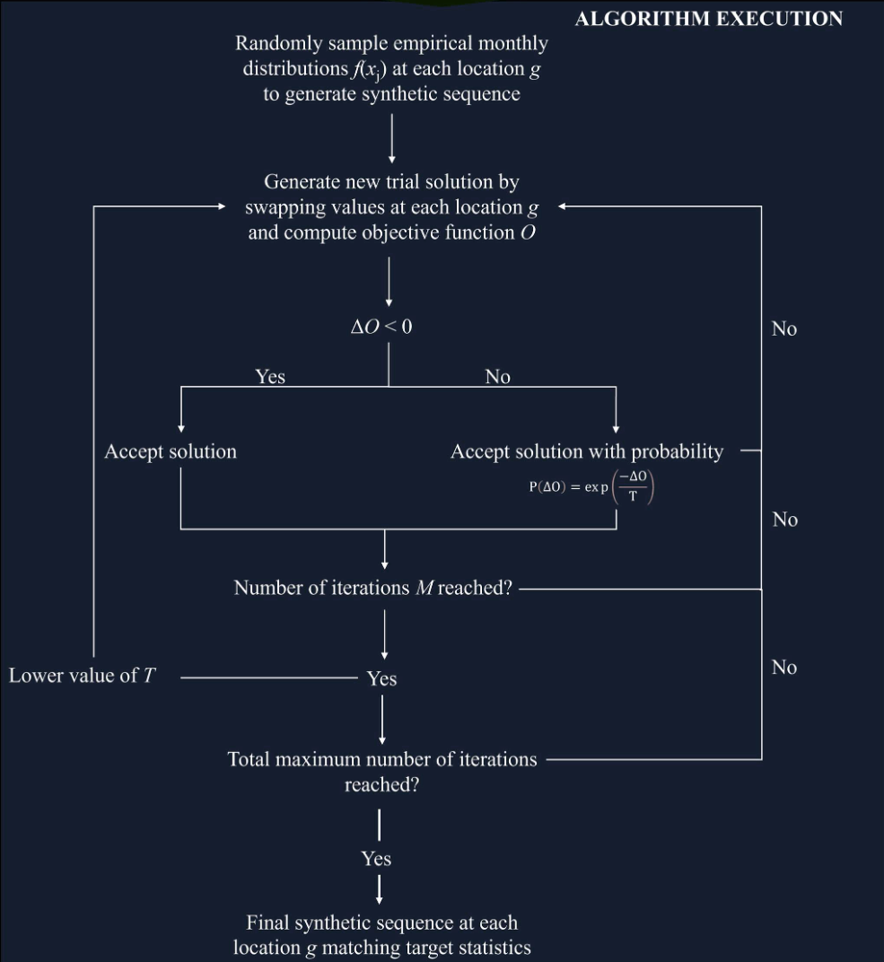
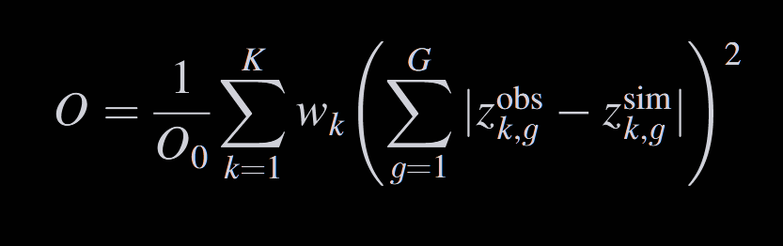
Synthetic generation literature reviews
Dec. 2024
The same simulated annealing-based generation as in Zaniolo et al. (2024). Differences are:
Focus on multiple sites using cross-site correlation matrix in the objective function
Hurst coefficient included in the objective function

Slide 4
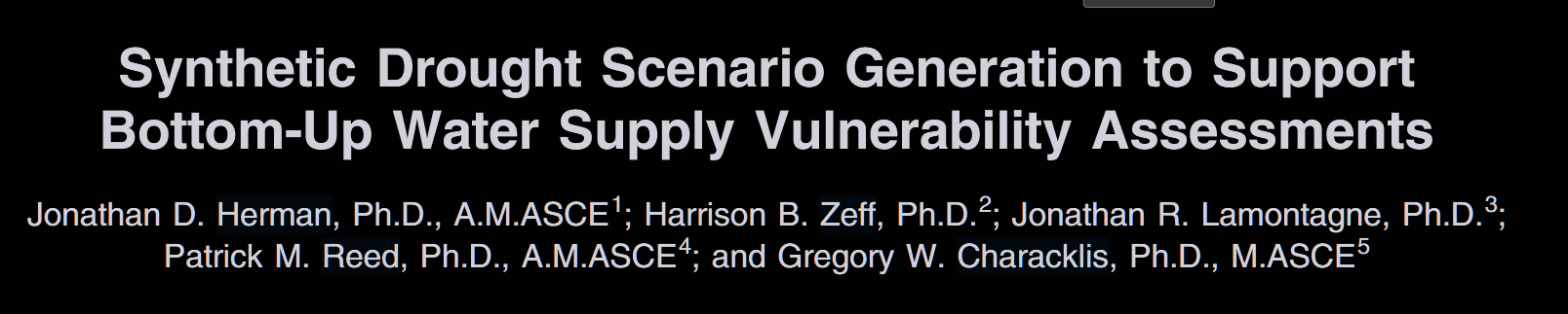
Synthetic generation literature reviews
Dec. 2024
“Borgomeo et al. (2015) provided perhaps the most general approach, in which streamflow generation is treated as a combinatorial optimization problem to match one or more user specified statistics of the resulting flows.”

Slide 5
Synthetic generation – breakdown of Kirsch
Historic Flow (Qh)
Detrend
Trend (m)
Zh
Remove Seasonality
Monthly Mean & Std Dev
Random Process (M)
Zs
Impose Correlation
Temporal & Spatial Corr.
Impose Seasonality
Impose Trend
Synthetic Flow (Qs)

Slide 6
Synthetic generation – breakdown of Kirsch
Climate Responses
Historic Flow (Qh)
Internal Variability
Detrend
Trend (m)
Zh
Remove Seasonality
Monthly Mean & Std Dev
Random Process (M)
Zs
Impose Correlation
Temporal & Spatial Corr.
Impose Seasonality
Impose Trend
Synthetic Flow (Qs)

Slide 7
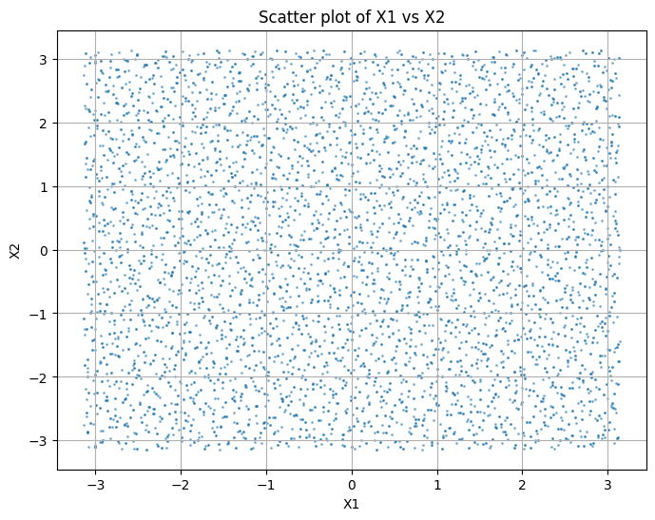




New generator proposal – testing the concept
Can Borg generate a Pareto Front with structured (sub) space?
Sampling for parameters X1 and X2
Obj.
Constr.
Borg MOEA
$$J$$
$$C$$
$$vars$$
$$f(vars)$$

Slide 8

New generator proposal – testing the concept
Objectives:
$$J_{1}= X_{1}$$
$$J_{2}= X_{2}$$

Slide 9
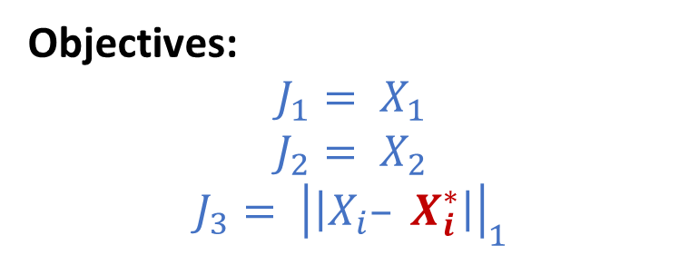
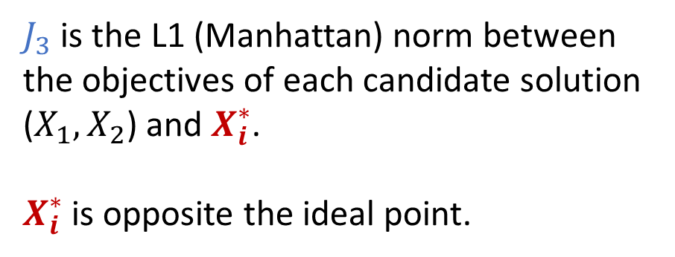

New generator proposal – testing the concept
$$X_{i}^{∗}$$
Objectives:
$$J_{1}= X_{1}$$
$$J_{2}= X_{2}$$
$$J_{3}= {\left|\left|X_{i}– X_{i}^{∗}\right|\right|}_{1}$$
$J_{3}$ is the L1 (Manhattan) norm between the objectives of each candidate solution ($X_{1}, X_{2}$) and $X_{i}^{∗}$.
$X_{i}^{∗}$ is opposite the ideal point.

Slide 10
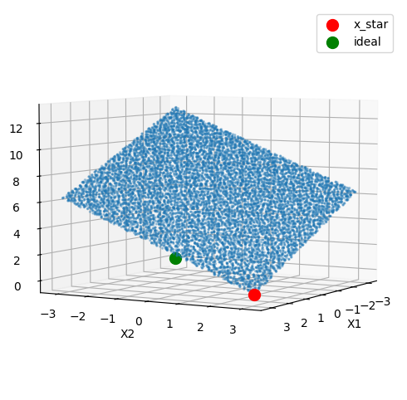
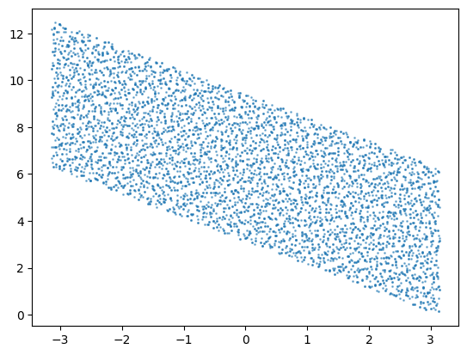
New generator proposal – testing the concept
Still showing points (X1, X2) from Sobol sampling.
L1 (Manhattan) Norm from X*
L1 (Manhattan) Norm from X*
X1
The Sobol samples are on the Pareto Front w/r/t $J$

Slide 11
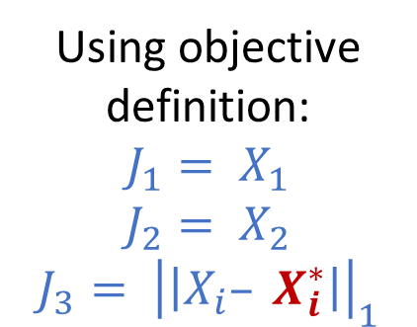
New generator proposal – testing the concept
Generate structured samples
Generate Pareto Front using Borg
Using objective definition:
$$J_{1}= X_{1}$$
$$J_{2}= X_{2}$$
$$J_{3}= {\left|\left|X_{i}– X_{i}^{∗}\right|\right|}_{1}$$
Show that samples lie on the Pareto Front
Show that Pareto Front (projection) reflect structured samples

Slide 12
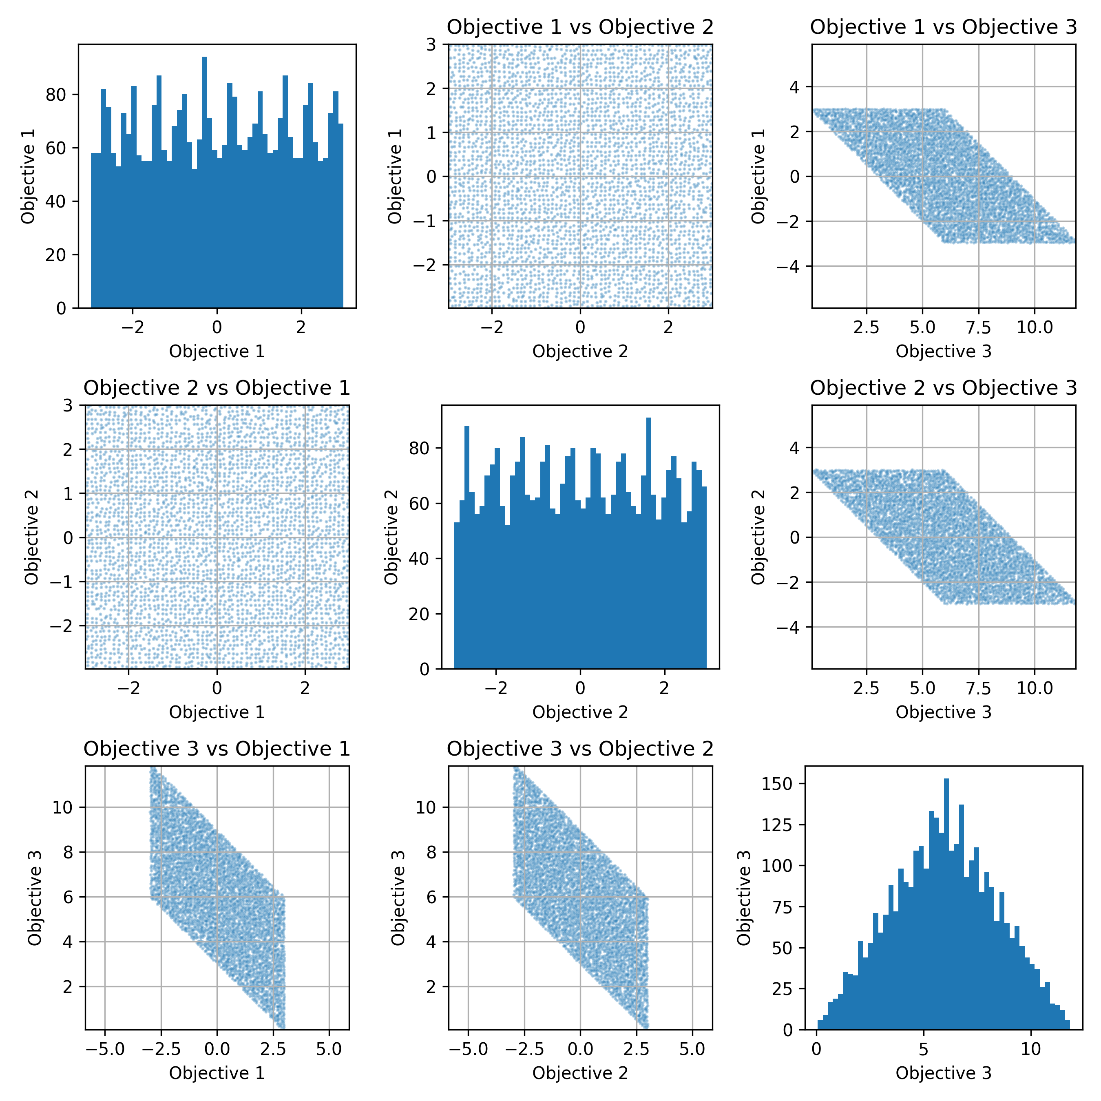
New generator proposal – testing the concept
X2
L1 (Manhattan) Norm from X*
X1
X1

Slide 13
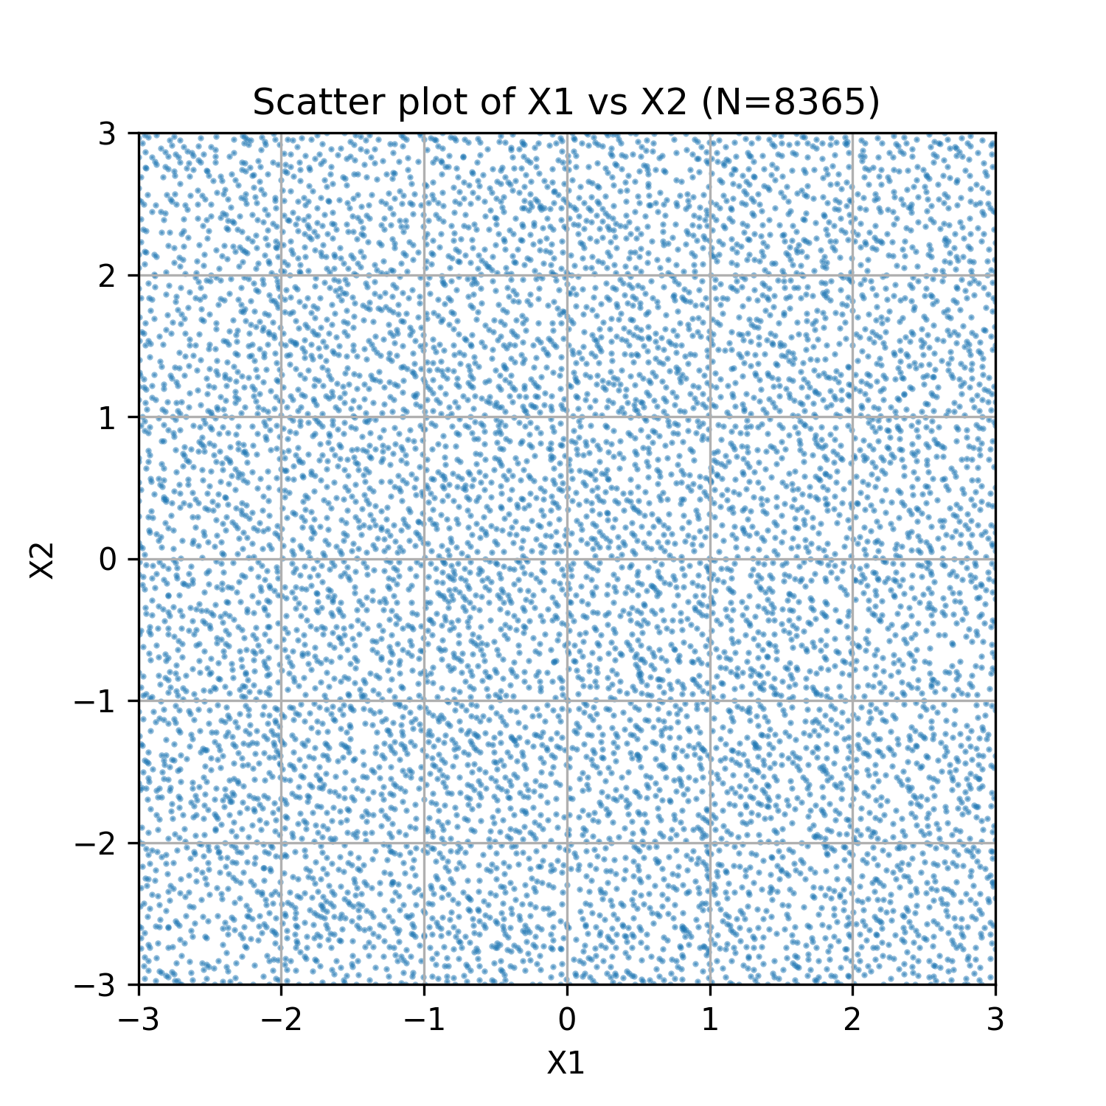
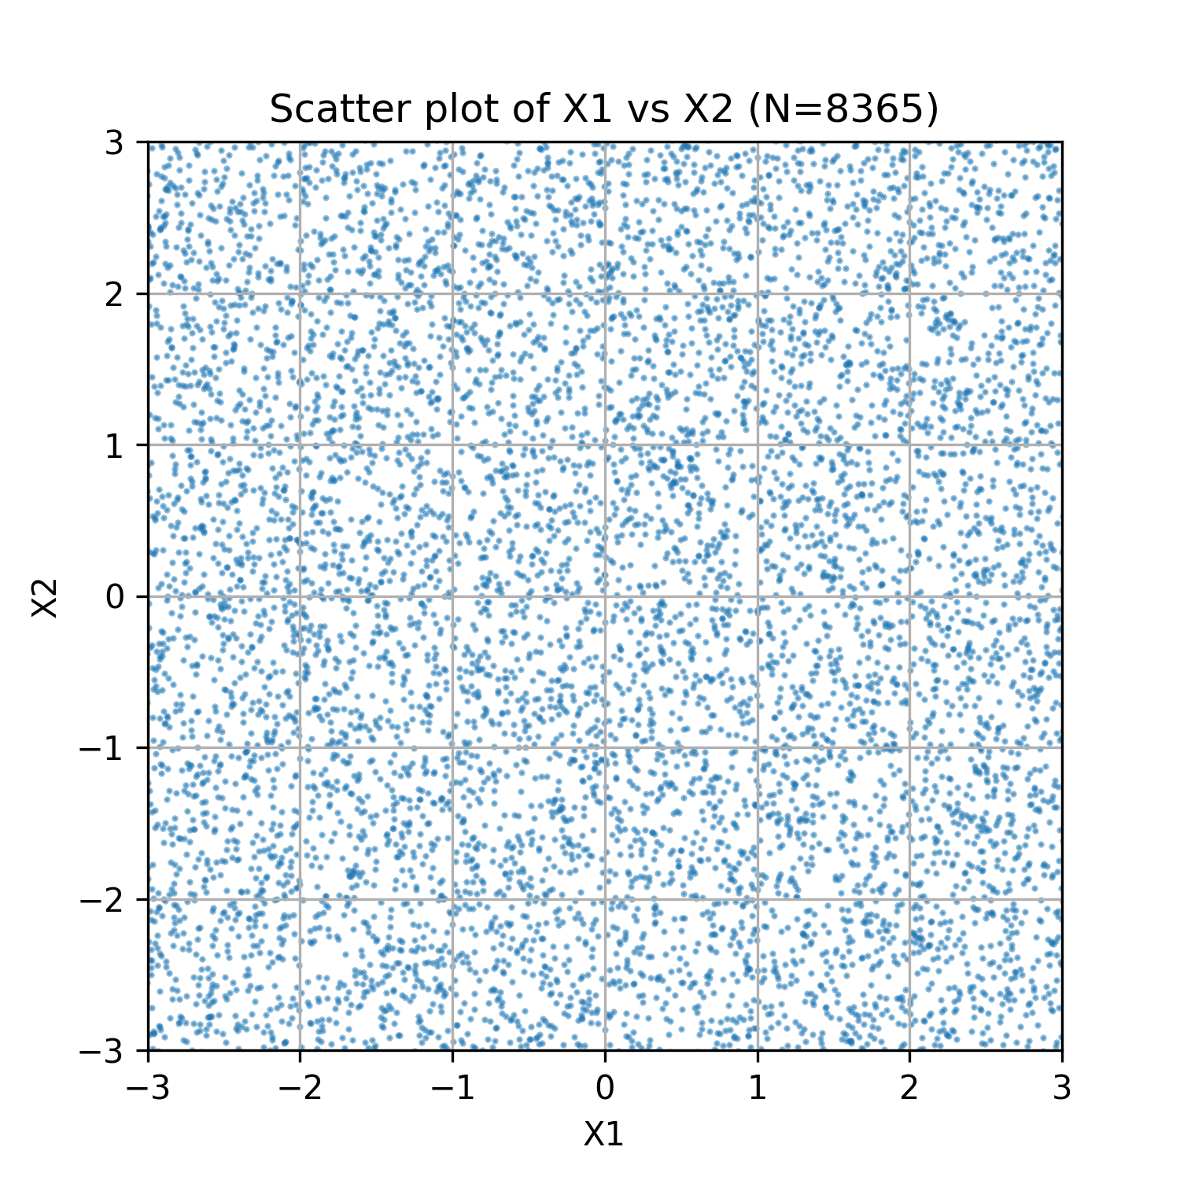
New generator proposal – testing the concept
Guess which dataset is an LHS and which is the PF generated by Borg?

Slide 14
New generator proposal – testing the concept
Pareto Solutions from Borg
LHS Sample

Slide 15
New generator proposal – testing the concept
Generate structured samples
Generate Pareto Front using Borg
Using objective definition:
$$J_{1}= X_{1}$$
$$J_{2}= X_{2}$$
$$J_{3}= {\left|\left|X_{i}– X_{i}^{∗}\right|\right|}_{1}$$
Show that samples lie on the Pareto Front
Show that Pareto Front (projection) reflect structured samples

Slide 16










New generator proposal: Motivation
Use Borg to search for bootstrap samplings that result in sampling of any desired drought characteristics.
Obj.
Constr.
Borg MOEA
$$J$$
$$C$$
$$Q_{t}$$
Block Bootstrap Generator (Kirsch)
$$Q_{H}$$
$$+$$
$$M$$
$$Q_{S}$$
In multi-objective context, the Pareto Front can correspond to the ensemble of synthetic droughts.
$$Q_{t}$$
$$D_{In}$$
$$D_{D}$$

Slide 17


New generator proposal – practical plan
$$Relative Drought Duration$$
Historic Mean
$$Relative Drought Intensity$$
*Mock-up, not real data

Slide 18
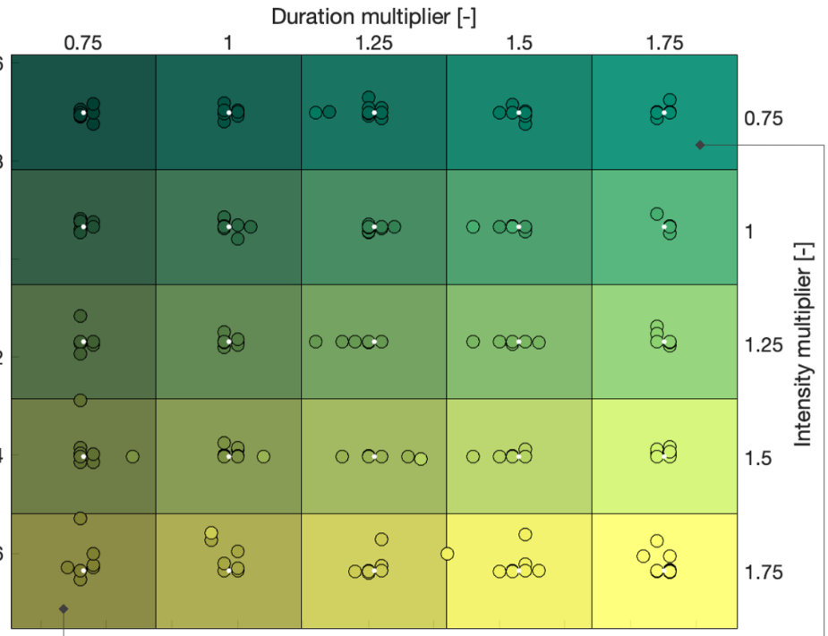
New generator proposal – practical plan
$$Relative Drought Duration$$
Historic Mean
$$Relative Drought Intensity$$
*Mock-up, not real data

Slide 19
New generator proposal – practical plan
WRF 2050s Scenario
1960s (e.g., Reconstruction Median)
$$Relative Drought Duration$$
Historic Mean
Other historic droughts
$$Relative Drought Intensity$$
*Mock-up, not real data

Slide 20







New generator proposal – practical plan
$$Q_{H}$$
Calc reference (Mean) Drought Stats
Borg MOEA
$$J$$
Calc Drought Stats
Block Bootstrap Generator (Kirsch)
$$Q_{H}$$
$$+$$
$$M$$
$$Q_{S}$$
$$Q_{S_{i}}$$

Slide 21
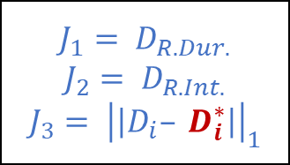
New generator proposal – practical plan
Calc reference (Mean) Drought Stats
$$J_{1}= D_{R.Dur.}$$
$$J_{2}= D_{R.Int.}$$
$$J_{3}= {\left|\left|D_{i}– D_{i}^{∗}\right|\right|}_{1}$$
$$Q_{H}$$
Borg MOEA
$$J$$
Calc Drought Stats
Block Bootstrap Generator (Kirsch)
$$Q_{H}$$
$$+$$
$$M$$
$$Q_{S}$$
$$Q_{S_{i}}$$

Slide 22

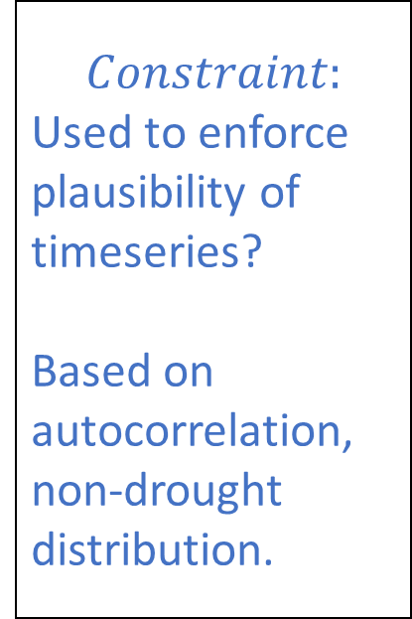
New generator proposal – practical plan
Calc reference (Mean) Drought Stats
$$Constraint:$$
Used to enforce plausibility of timeseries?
Based on autocorrelation, non-drought distribution.
$$Q_{H}$$
Borg MOEA
$$J$$
$$C$$
Block Bootstrap Generator (Kirsch)
$$Q_{H}$$
$$+$$
$$M$$
$$Q_{S}$$
$$Q_{S_{i}}$$

Slide 23
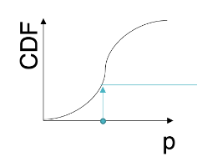

New generator proposal – practical plan
$$Q_{H}$$
Calc reference (Mean) Drought Stats
$$Decision var:$$
Monthly bootstrap sample index.
OR:
CDF sample probability.
Borg MOEA
$$J$$
$$C$$
Block Bootstrap Generator (Kirsch)
$$Q_{H}$$
$$+$$
$$M$$
$$Q_{S}$$
$$Q_{S_{i}}$$

Slide 24
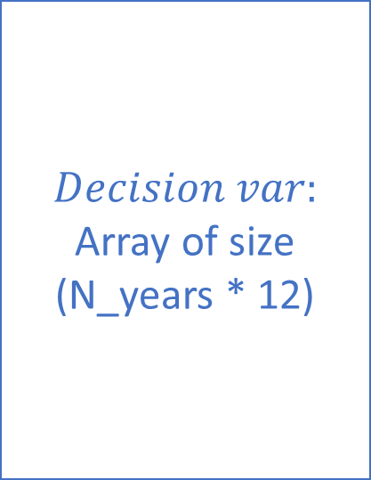
New generator proposal – practical plan
$$Q_{H}$$
Calc reference (Mean) Drought Stats
$$Decision var:$$
Array of size
(N_years * 12)
Borg MOEA
$$J$$
$$C$$
Block Bootstrap Generator (Kirsch)
$$Q_{H}$$
$$+$$
$$M$$
$$Q_{S}$$
$$Q_{S_{i}}$$

Slide 25



New generator proposal – practical plan
$$Q_{H}$$
Calc reference (Mean) Drought Stats
Borg MOEA
$$J$$
$$C$$
Calc. Drought Stats
$$Q_{S}$$
Block Bootstrap Generator (Kirsch)
$$Q_{H}$$
$$+$$
$$M$$
$$Q_{S}$$
$$Q_{S_{i}}$$
$$D_{R.In}$$
$$D_{R.Dur}$$

Slide 26

New generator proposal – practical plan
Other considerations:
How to generate series for multiple sites?
The block bootstrapping (Kirsch) enforces multi-site correlation by using the same sampling indices for each site.
How to generate demand timeseries?
Two options:
Treat demand as another ‘site’ in the bootstrap; correlation will be imposed automatically
Explicitly model the demand as a stochastic process with a given correlation structure (the correlation can be treated as another factor)
Regress: f(streamflow anomalies) -> demand anomalies (done in Hadjimichael et al.)
$$M$$

